Slide 1
NBA Player Database
A work in progress by: Scott Kuhlman

Slide 2
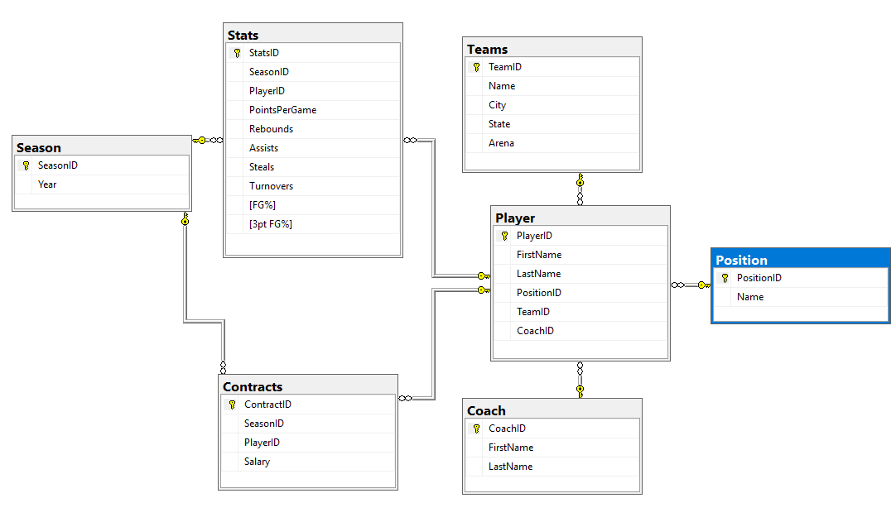
DataBase Diagram

Slide 3

Teams Table

Slide 4

Players Table

Slide 5

Players Statistics Table

Slide 6

Positions Table

Slide 7

Coaches Table

Slide 8

Contracts Table

Slide 9

Seasons Table

Slide 10
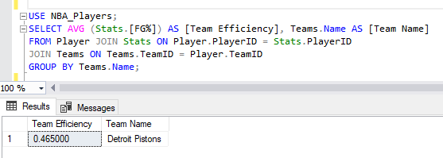

Summary Queries

Slide 11
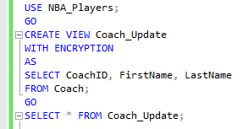
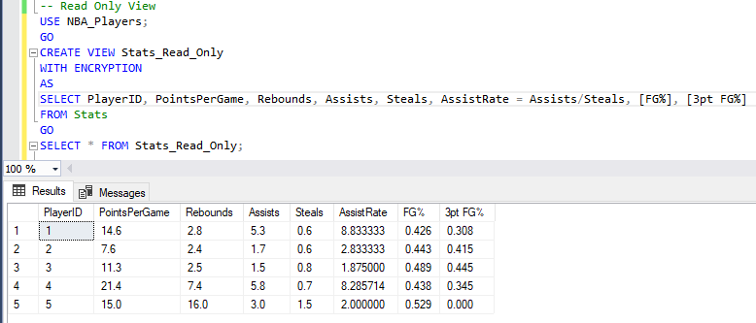
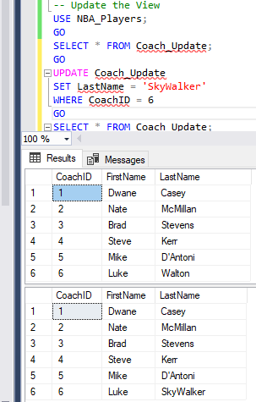
Views

Slide 12
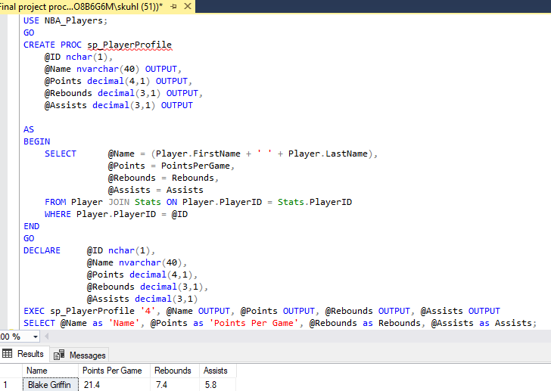
Stored Procedures

Slide 13
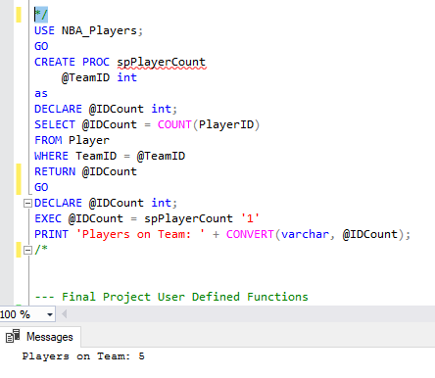
Stored Procedures

Slide 14
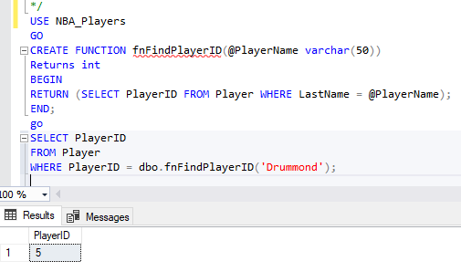
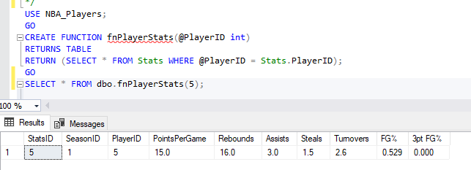
Functions

Slide 15
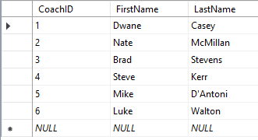
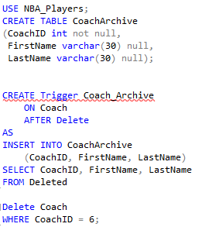
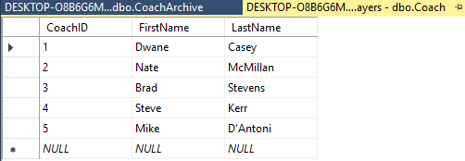

Triggers

Slide 16

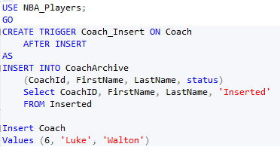
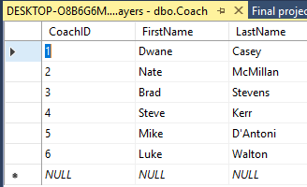
Triggers

Slide 17
FIN

